Slide 1

Data Visualisation using Tableau
What is a Tableau?
Tableau vivant, a motionless performance evoking a painting or sculpture; or a painting or photograph evoking such a theatrical scene. Scene (drama), in opera, ballet, and some other dramatic forms
Data Visualisation using Tableau
It helps users create different charts, graphs, maps, dashboards, and stories for visualizing and analyzing data, to help in making business decisions.
Tableau has a lot of unique, exciting features that make it one of the most popular tools in business intelligence (BI).

Slide 2
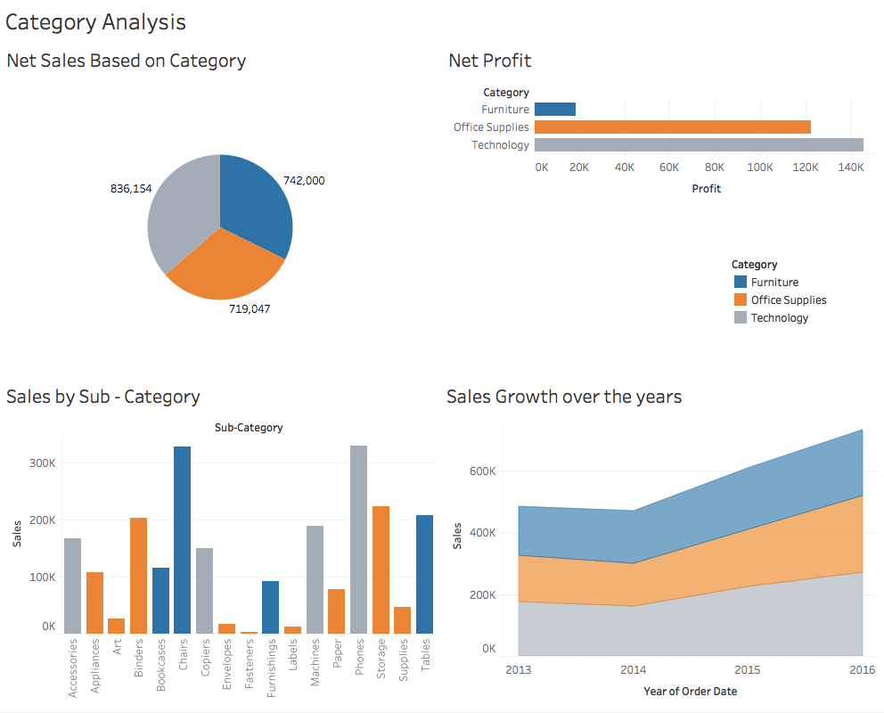
Important Charts and graph used in Tableau for Data Visualisation

Slide 3
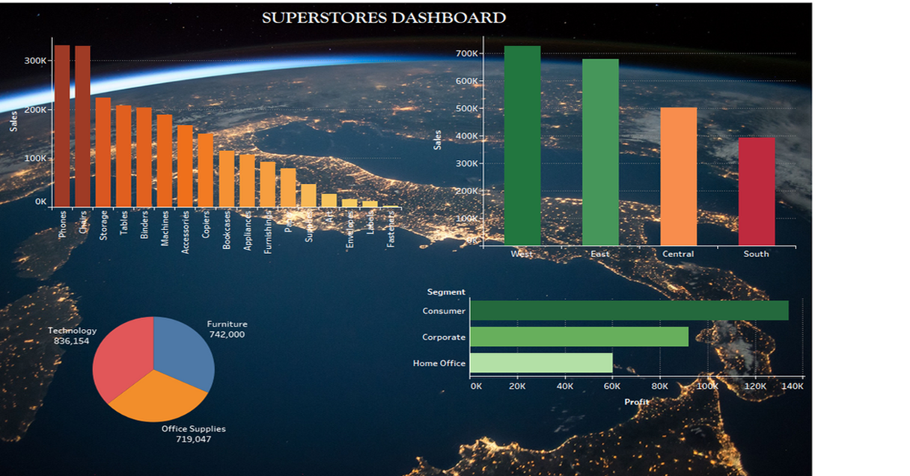
Dashboard
The main use of a dashboard is to show a comprehensive overview of data from different sources.
Dashboards are useful for monitoring, measuring, and analyzing relevant data in key areas.

Slide 4
HealthCare Analytics Capstone Project
Using Tableau

Slide 5

Healthcare Analytics

Slide 6
Connect to the Healthcare Analytics dataset and build a Dashboard that will show the Health Analysis of People
View 1: Diabetic/Non-diabetic using Shapes
View 2: Patient summary by Blood Pressure category
View 3: Create a Histogram to show Body Mass Index (BMI) by Age Groups
View 4: Single Bar showing percent distribution of patients by BMI type
View 5: Bar Chart showing Patient break down by Blood Pressure and Diabetes
View 6: Build a HEAT MAP showing several health factors by Age group

Slide 7
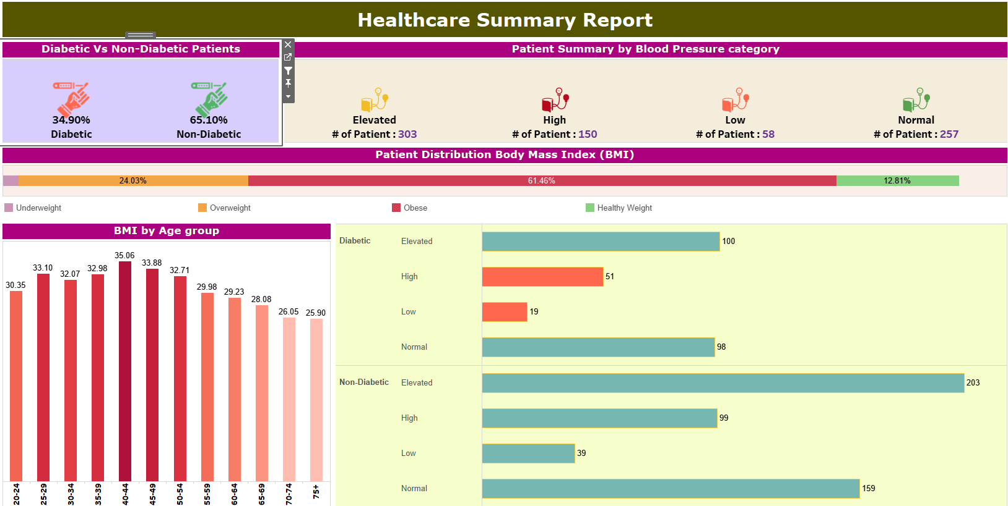
Healthcare Summary Report

Slide 8
THANK YOU

